Slide 1
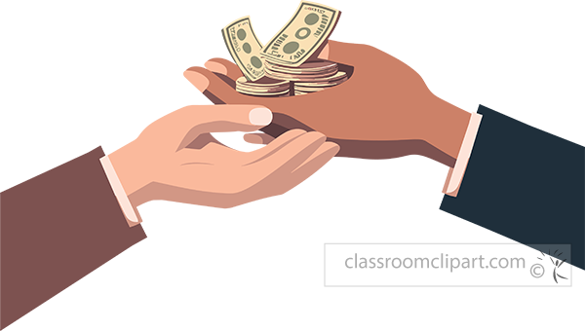
Mukando Manager
A savings group manager that tracks who has paid and whose turn it is to receive the pool.
Group 4 - Case 13
Amie Zengeya - 260108 · Runakorwashe Nyamanhindi - 262294 · Leah Kahonde - 260657 · Mtendere Kanjodo- 260675 · Mutsa Magombei- 250307
Notes:
About 15 seconds. Introduce the group and each member by name and by the part they built. One line on what the program does: it tracks who has paid and whose turn it is to receive the monthly payout. Then hand over to [Name] for the problem. Fill in the group number and member names on this slide before presenting.

Slide 2
Who has paid, and whose turn is it?
THE PROBLEM
01
02
03
Everyone contributes
One member receives
Recorded on paper
Each member pays into the pool every month.
Each month, one member takes the whole pool, in turn.
Payments and payouts are written in a notebook.
Leads to disputes about who paid and who has been paid.
Notes:
About 30 seconds for this slide, about 1 minute with the next one. Say in your own words: savings groups are common across Africa. Members contribute every month and take turns to receive the pool. Everything is written in a notebook, so arguments about who paid and who has been paid keep happening. Hand over to [Name] for who the program is for.

Slide 3




Built for Mukando group members
WHO IT’S FOR
Track payments
See who has paid and who is behind.
Know the turn
Who uses it
See whose turn it is to receive the payout.
People who are part of Mukando groups.
Keep one record
Replace the notebook with a saved record.
Notes:
About 30 seconds. The users are people who belong to Mukando groups. What they need: to keep track of who has paid, and to know whose turn it is to receive the payout. The saved record is what replaces the notebook. Hand over to [Name] for the breakdown.

Slide 4

What goes in, what comes out
OUR BREAKDOWN
Inputs
Outputs
Member names
Monthly contribution amount
Current month
Payment details
Payout recipient
Registered members
Payment records
Members behind on payments and members up to date
Total savings
Payout records
Confirmation messages
Notes:
About 25 seconds. Keep the next five slides to about 2 minutes in total. Inputs are what the user types in: member names, the monthly contribution amount, the current month, payment details and the payout recipient. Outputs are what the program shows or saves: the member list, payment records, who is behind and who is up to date, total savings, payout records and confirmation messages. Speaker: [Name].

Slide 5
What we store, and how
OUR DESIGN
class
class
Member
Group
One object for each member of the group.
Manages the group: its members, payments and payouts.
list
dict
Members and payout order
Monthly payments
Holds every member, in the order they receive the pool.
Records who has paid in each month.
Notes:
About 25 seconds. Two classes and two collections. A Member object for each person. A Group object that manages the whole group. A list holds the members and the order in which they receive the pool. A dictionary holds the monthly payments. Everything is saved to one text file. If you want, add the attributes of Member and Group here once the code is final. Speaker: [Name].

Slide 6
How the pieces fit together
OUR DESIGN
FUNCTIONS
Group
class
register_member()
Add a new member to the group
Manages the members, the payout order and the monthly payments.
record_payment()
Log a member’s monthly payment
record_payout()
Pay the pool to the recipient
Member
One per member, held by the Group.
show_status()
Report who is paid up or behind
save_records()
Write all records to the file
Notes:
About 40 seconds. This is the diagram slide. The Group class holds the Member objects and does the managing. Five functions, each with one clear job: register a member, record a payment, record a payout, show the status, and save the records. Point at each row as you name it. Check that the one-line jobs match what your functions really do. Speaker: [Name].

Slide 7
What can go wrong
ERROR HANDLING
1
Duplicate members
2
Negative contribution
Check the name before adding; show a message if it already exists.
Reject the amount and ask for a valid one.
3
Insufficient funds for a payout
4
Payment not recorded
Check the pool first; refuse the payout and show the shortfall.
The member stays on the behind list until a payment is saved.
Notes:
About 20 seconds. Four things can go wrong: duplicate members, a negative contribution, not enough money for a payout, and a payment that is never recorded. For each one, say what the program does. The wording of how each case is handled is a first draft, so edit it to match what your code really does (checks before an action, or try and except). These cases come back in the demo. Speaker: [Name].

Slide 8
Who built what
Registration
Payout management
File handling
[Mutsa Magombei]
[Leah Kahonde]
Member and Group classes
[Amie Zengeya]
save_records()
register_member()
record_payout()
Payment tracking
Error Handling
[Mtendere Kanjodo]
[Runakorwashe Nyamanhindi]
record_payment()
Member and Group classes
show_status()
register_member()
Notes:
Appendix slide. Replace each [Member name] with the person who owns that part. The split follows the group's breakdown sheet: registration, payment tracking, payout management and file handling, with the presentation shared by everyone. The Member and Group classes sit under registration, and show_status sits under payment tracking. Move them if your group split the work differently.

Slide 9
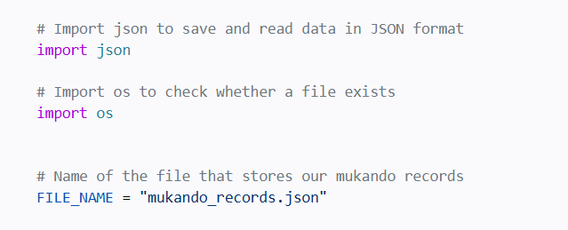
Imports and Files
What it does
json turns Python dictionaries lists into text and back into Python dictionaries
os lets the program ask whether the program exists or not.
Mukando records saved in mukando_records.json.
Notes:
Appendix slide, for when the lecturer asks about registration or when you walk through the code. Replace the grey comment lines in the dark panel with your final Member class, Group class and register_member() function, and rename [filename].py. Keep it to about 15 lines so it stays readable. Explain in plain words: what a Member holds, how the Group stores members, and how duplicate names are refused. Presenter: [Name].

Slide 10
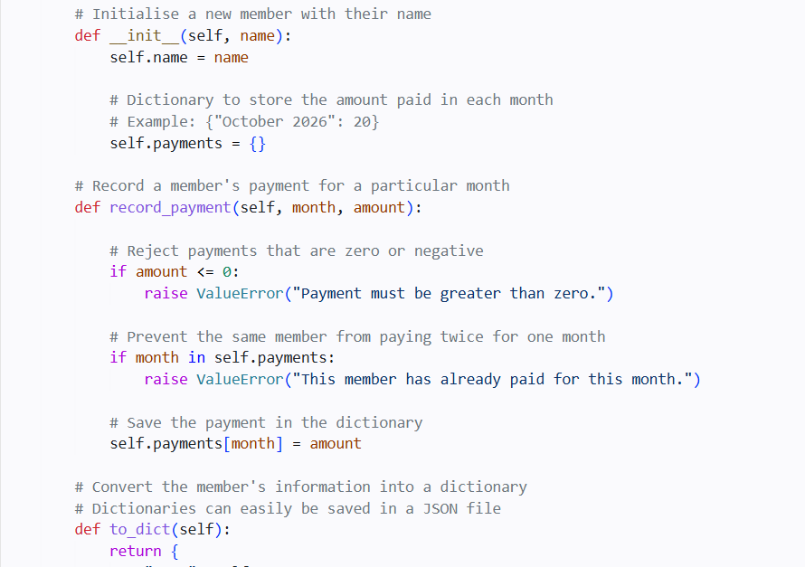
Registering members
What it does
Each Member object represents one person.
Stores a name and payment in a dictionary where the key is the month and value of the amount
Adds members to the Group list
Rejects duplicate names
Sets the monthly amount
Notes:
Appendix slide, for when the lecturer asks about registration or when you walk through the code. Replace the grey comment lines in the dark panel with your final Member class, Group class and register_member() function, and rename [filename].py. Keep it to about 15 lines so it stays readable. Explain in plain words: what a Member holds, how the Group stores members, and how duplicate names are refused. Presenter: [Name].

Slide 11
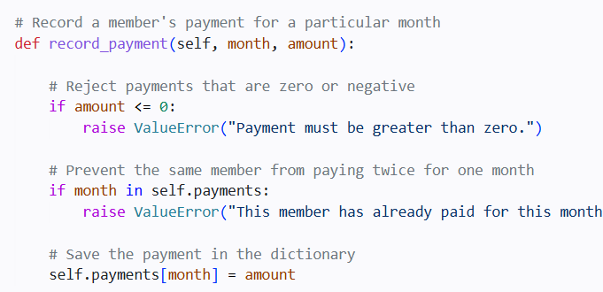
Recording payments
What it does
Records each member’s monthly payment
Rejects negative amounts
Lists who is behind and who is up to date
Shows the group’s total savings
Mukando Manager · CSC1101
Notes:
Appendix slide, for when the lecturer asks about payments or when you walk through the code. Replace the grey comment lines in the dark panel with your final record_payment() and show_status() functions. Keep it to about 15 lines. Explain in plain words: how a payment is stored in the monthly payments dictionary, what happens with a negative amount, and how the program works out who is behind. Presenter: [Name].

Slide 12
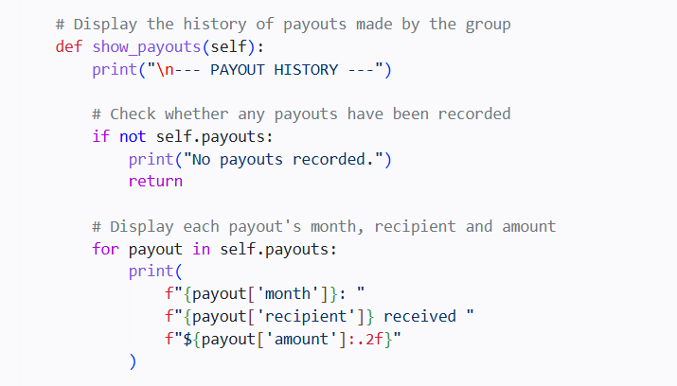
Managing payouts
What it does
Decides whose turn it is
Checks the pool has enough money
Records the payout
Moves on to the next member in the order
Mukando Manager · CSC1101
Notes:
Appendix slide, for when the lecturer asks about payouts or when you walk through the code. Replace the grey comment lines in the dark panel with your final record_payout() function and the code that decides the payout order. Keep it to about 15 lines. Explain in plain words: how the program knows whose turn it is, what it checks before paying out, and what it shows when there is not enough money. Presenter: [Name].

Slide 13
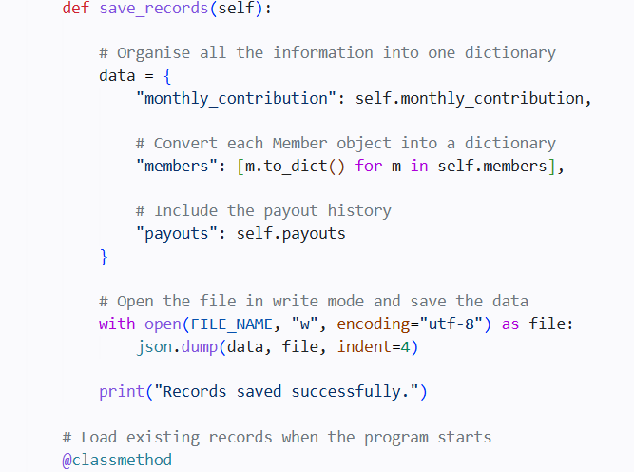
Saving the records
What it does
Saves members, payments and payouts
Writes everything to one text file
Loads the records when the program starts
Handles a missing file
Mukando Manager · CSC1101
Notes:
Appendix slide, for when the lecturer asks about the file or when you walk through the code. Replace the grey comment lines in the dark panel with your final save_records() function and the code that loads the file when the program starts. Keep it to about 15 lines. Explain in plain words: what the text file looks like, what is saved, and what the program does if the file is missing. If you can, show the file itself open next to the code. Presenter: [Name].

Slide 14
Questions?
Notes:
About 1 minute. Thank the class and invite questions. Every member must be ready to open the code and explain any function, so if a question is about a specific part, go to the matching slide in the appendix (team, registration, payments, payouts, file handling) or open the code directly. If a question is about a mistake the program handles, return to the errors or tests slide.

